Slide 1
DRAFT
Benefit Ally Market Expansion for FI 51-99 on USP
Phase 2 – Release 1
Solution Intent version 2.0
2.11.26
Rajeev Mandi, ESA

Slide 2
Change History
Date | Author | Version | Description
12/15/2025 | Rajeev Mandi | 1.0 | Initial Draft
02/11/2026 | Rajeev Mandi | 2.0 | Updates to incorporate feedback & inputs from JAD sessions for FI51-99

Slide 3
DRAFT
Content Index
  Business Context:
      What is BA, Why are we implementing BA, how does it Work
      BA Markets by numbers
      BA Scope FI 51-99
      BA High Level Requirements by Phases
      UHC Product Model v2.1 Impacts
  Architecture Context:
      Business Capabilities
      Current State
  Solution Capabilities:
      Solution Approach
      Application Impacts
  Appendix

Slide 4



What is Benefit Ally?
Benefit Ally bundles medical and supplemental coverage to help reduce the financial impact of catastrophic health events. The plan automatically sends cash payments directly to employees for medical events, including:
Accidents*–
dislocations, fractures
and eye injuries
Critical illnesses–
cancer, heart attacks
and strokes
Hospital indemnity–
hospital and ICU
admissions and stays

Slide 5
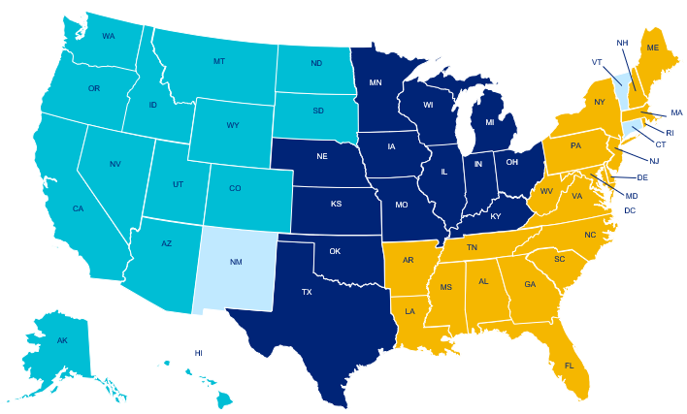
UnitedHealthcare Benefit Ally by the numbers
Health Plans | Benefit Ally
Operations in 48 states including DC and growing
48 | Active markets where we sell UnitedHealthcare Benefit Ally®
>300 | Active clients who have purchased Benefit Ally
>75K | Members who are active within the Benefit Ally program
$10.8M | In Benefit Ally benefits that have been made since program inception
70 | Net Promoter Score® (NPS®)
1-3% | Or less of the FI medical premium; Value: $10.75 PMPM Enhanced: $15.09 PMPM
You may hear
feedback like:
Great program. Especially when facing a serious health crises and need to meet a deductible.
It was the perfect time. Thank you for helping.
It certainly helped cover medical bills.
This payment was unexpected but very appreciated, as it was definitely helpful while recovering.
Benefit Ally
Markets by region
West
Central
East
Not filed/approved
Net Promoter, Net Promoter System, Net Promoter Score, NPS and the NPS-related emoticons are registered trademarks of Bain & Company, Inc., Fred Reichheld and Satmetrix Systems, Inc. Source: UnitedHealthcare Key Account Fully Insured Book of Business, 2020-3/31/2025.
Notes:
Source: UnitedHealthcare Key Account Fully Insured Book of Business, 2020-3/31/2025.

Slide 6

Here’s how it works…
A
Employer includes Benefit Ally on one or more medical plans (included in medical quote, no FP implementation, no FP enrollment or eligibility)
B
Employee enrolls in medical plan with Benefit Ally during Open Enrollment
1
Employee/Member has qualifying medical event
2
The system monitors claims to identify the ones that are eligible for supplemental benefits, automatically triggering payments*
3
Employee continues to pay their share of the costs, as defined by their plan
4
Employee automatically receives a supplemental benefit payment for qualified medical events
C
Employer receives one invoice (medical bill includes Benefit Ally premium)
Notes:
Notes:
Benefit Ally integrates supplemental health benefits with medical benefits, no claim forms required.
The system monitors claims to identify the ones that are eligible for supplemental benefits, automatically triggering payments. When an employee has a qualified medical event, they will automatically receive supplemental health benefits, such as critical illness, hospital indemnity or accident. No additional decision is needed from the employee (like with dental, vision or supplemental health today).
Here’s how Benefit Ally works:
An employee has a qualifying medical event.
Benefit Ally identifies UnitedHealthcare medical claims that may be eligible for supplemental health benefits.
The employee continues to pay their share of the costs, as defined by their plan.
The employee automatically receives a supplemental benefit payment for qualified medical events.

Slide 7
Benefit Ally LG 51-99 Market Expansion - Scope
Impact | Output
Launch Date | Launching 4/1/2027 Quote Ready for 7/1/2027 Case Effective - New Business
Business Partners / Business Capabilities | Sales, UW, Case Install, Supplemental Health, Marketing, Customer Service, Billing, Comp/Commissions, Member Enrollment, Fulfillment, Finance, Reporting, and Portals
Funding Type and Line of Business | Funding Type/LOB: FI, LG 51-99 Plans: Includes UHC, and Oxford Markets Excluded: CT, VT, NM, CA, NY Plans Excluded: NICE, Level Funded, Sierra, UMR, Grandfathered plans, Transitional Groups and Surest. ( note: Cannabis Groups are included and can be offered BA)
Medical Products/Network | All UHC/Oxford FI 51-99
Platform | USP
MVP Markets | All Except NM, CT, VT, CA, NY
Membership | 20K+

Slide 8
Capability Overview – Phase 1 & 2
(High Level requirements for FI 51-99)
Phase 1 R1 – New Business
Name | Functionality Required | In Scope | Out of Scope | Team
Oxford Quoting – Phase 1 | Non Newton2 development requirement is to create the ability to quote on all new and existing/renewal business across all pricing tools for Benefit Ally Oxford FI 51-99. Update the (digital?) UAF to include Benefit Ally for Oxford FI 51-99. The three supplemental health rates should be added to the medical premiums. This should follow the EXACT same process for the KA Oxford NJ quote. | NJ | CT and NY | Adam Raimondi
UHC Quoting – Phase 1 | Create the ability to quote on all new and existing/renewal business across all pricing tools for Benefit Ally UHC FI 51-99. Update the UAF to include Benefit Ally for UHC FI 51-99. Newton2 business requirements found on Tab 2. | AK, AL, AR, AZ, DC, DE, FL, GA, HI, IA, ID, IL, IN, KS, KY, LA, MA, MD, ME, MI, MN, MO, MS, MT, NC, ND, NE, NH/Including Freedom, NJ, NV, OH, OK, OR, PA, RI, SC, SD, TN, TX, UT, VA, WA, WI, WV, WY, CO | NM, CT, VT, CA, NY | Andy Christakis
Case Installation and Implementation – Phase 2 | Create the ability to install Benefit Ally onto USP for UHC and Oxford 51-99 which includes foundational automation. Included within this work would be requesting we digitize the UHC and Oxford UAF to reduce implementation errors. Ensure there are processes in place to support COBRA, a retroactive add of Benefit Ally, and a change in plan design for Benefit Ally. Additionally, the case installation and implementation teams are responsible for ensuring the group situs state is accurately documented and used for all downstream teams' setup (i.e. NY experience is different than all other states). Case Install/Implementation to ensure taxes task is established and setup for policy. | AK, AL, AR, AZ, DC, DE, FL, GA, HI, IA, ID, IL, IN, KS, KY, LA, MA, MD, ME, MI, MN, MO, MS, MT, NC, ND, NE, NH, NJ, NV, OH, OK, OR, PA, RI, SC, SD, TN, TX, UT, VA, WA, WI, WV, WY, CO Oxford Markets: NJ | NM, CT, VT, CA, NY | Elizabeth Sullivan (Oxford) Serissa Jones (UHC)
Supplemental Health/Benefit Ally Plan Detail – Phase 1 | Add all active states into plan library to make accessible for the 51-99 membership on USP which will provide benefit level detail by state and plan (Enhanced or Value) for Benefit Ally which will provide downstream setup information to impacted teams/processes (i.e. COC). For reference, 2 states are currently loaded into plan library (NY/NJ) for Oxford KA FI 100+. This work needs to be completed for Oxford and UHC. Please note the in-scope markets refer to 51-99 only; we will not enable the out-of-scope markets for 51-99 | AK, AL, AR, AZ, DC, DE, FL, GA, HI, IA, ID, IL, IN, KS, KY, LA, MA, MD, ME, MI, MN, MO, MS, MT, NC, ND, NE, NH, NJ, NV, OH, OK, OR, PA, RI, SC, SD, TN, TX, UT, VA, WA, WI, WV, WY, CO Oxford Markets: NJ | NM, CT, VT, CA, NY | Brent Price
Phase 2 R1 – New Business
Phase 1 R1 – New Business

Slide 9
Capability Overview – Phase 2
(High Level requirements for FI 51-99)
Name | Functionality Required | In Scope | Out of Scope | Team
Billing | The standard business requirement is to have the medical and supplemental health premiums billed together (combined into one rate) on a monthly basis. The business also requires that we have the ability to book revenue across any license (i.e. medical license may differ from supplemental). We also need the functionality to break premiums out if requested by the client; meaning benefit ally rates should be separate from medical. This is the same exact functionality offered for Oxford KA 100+ FI NY and NJ. | AK, AL, AR, AZ, DC, DE, FL, GA, HI, IA, ID, IL, IN, KS, KY, LA, MA, MD, ME, MI, MN, MO, MS, MT, NC, ND, NE, NH, NJ, NV, OH, OK, OR, PA, RI, SC, SD, TN, TX, UT, VA, WA, WI, WV, WY, CO Oxford Markets: NJ | NM, CT, VT, CA, NY | Shelly Salemi
Commissions and Bonus | Build the Benefit Ally commission structure for all states is now variable (currently built within USP); 0-25% for all in scope states; does not apply to NY. There are states where there are max commission amounts that we must adhere to. | AK, AL, AR, AZ, DC, DE, FL, GA, HI, IA, ID, IL, IN, KS, KY, LA, MA, MD, ME, MI, MN, MO, MS, MT, NC, ND, NE, NH, NJ, NV, OH, OK, OR, PA, RI, SC, SD, TN, TX, UT, VA, WA, WI, WV, WY, CO Oxford Markets: NJ | NM, CT, VT, CA, NY | Rosemarie Williams Joel Shaw
Sales Compensation | Ensure data flows and is accessible to Bob Carrigan (Finance) team to book compensation for sales for Benefit Ally |  |  | Bob Carrigan
Supplemental Health Finance | Ensure that we create the appropriate supplemental health financial structure to book revenue; there are three bill item types that can be booked by the Supplemental Health Finance team and be able to book revenue across multiple licenses (financial tagging) | AK, AL, AR, AZ, DC, DE, FL, GA, HI, IA, ID, IL, IN, KS, KY, LA, MA, MD, ME, MI, MN, MO, MS, MT, NC, ND, NE, NH, NJ, NV, OH, OK, OR, PA, RI, SC, SD, TN, TX, UT, VA, WA, WI, WV, WY, CO Oxford Markets: NJ | NM, CT, VT, CA, NY | Sara Swenson
Supplemental Health Implementation | Send 51-99 FI Oxford and UHC data (claims and eligibility) from ARA to OnBase to setup policy within OnBase; Taxation will also be required to be setup within OnBase prior to client/policy activation and need stop gap to ensure data will not flow to OnBase until taxation is setup. | AK, AL, AR, AZ, DC, DE, FL, GA, HI, IA, ID, IL, IN, KS, KY, LA, MA, MD, ME, MI, MN, MO, MS, MT, NC, ND, NE, NH, NJ, NV, OH, OK, OR, PA, RI, SC, SD, TN, TX, UT, VA, WA, WI, WV, WY, CO Oxford Markets: NJ | NM, CT, VT, CA, NY | Kathy McBride Jonathan Mohr Uday Vishnudas
Supplemental Health Administration | Setup OnBase to ingest claims and eligibility information for the 51-99 FI UHC and Oxford membership to pay claims for each of the eligible markets. Ensure all materials sent to the member post processing like the EOB and buck slip are updated to reflect any state nuances (like NY) or to adhere to plan branding or license. OnBase must have all coding completed by market which should be completed as part of the USP expansion. Requesting we validate as part of solutioning discussions. | AK, AL, AR, AZ, DC, DE, FL, GA, HI, IA, ID, IL, IN, KS, KY, LA, MA, MD, ME, MI, MN, MO, MS, MT, NC, ND, NE, NH, NJ, NV, OH, OK, OR, PA, RI, SC, SD, TN, TX, UT, VA, WA, WI, WV, WY, CO Oxford Markets: NJ | NM, CT, VT, CA, NY | Kathy McBride Jonathan Mohr Uday Vishnudas

Slide 10
Capability Overview – Phase 2
(High Level requirements for FI 51-99)
Name | Functionality Required | In Scope | Out of Scope | Team
Supplemental Health Contracts & Fulfillment | Build an automated process - similar to Oxford FI NY/NJ 100+ where we can automate the COC and make accessible via Doc360; this requirement needs to be vetted with RRT team before we move forward with this requirement. | AK, AL, AR, AZ, DC, DE, FL, GA, HI, IA, ID, IL, IN, KS, KY, LA, MA, MD, ME, MI, MN, MO, MS, MT, NC, ND, NE, NH, NJ, NV, OH, OK, OR, PA, RI, SC, SD, TN, TX, UT, VA, WA, WI, WV, WY, CO Oxford Markets: NJ | NM, CT, VT, CA, NY | Jonathan Mohr, Valerie Martinez, Karthik Thilager, Michael Dircz
Member Access to Benefit Ally Information | DOB's accessible via myuhc.com - all documents MUST go through UA before posting - need process for this. | AK, AL, AR, AZ, DC, DE, FL, GA, HI, IA, ID, IL, IN, KS, KY, LA, MA, MD, ME, MI, MN, MO, MS, MT, NC, ND, NE, NH, NJ, NV, OH, OK, OR, PA, RI, SC, SD, TN, TX, UT, VA, WA, WI, WV, WY, CO Oxford Markets: NJ | NM, CT, VT, CA, NY | Jonathan Mohr, Valerie Martinez, Karthik Thilager and
Broker and Employer Access to Benefit Ally Information | Make COC's and invoices available via B&E portal for 51-99 for Oxford and UHC. | AK, AL, AR, AZ, DC, DE, FL, GA, HI, IA, ID, IL, IN, KS, KY, LA, MA, MD, ME, MI, MN, MO, MS, MT, NC, ND, NE, NH, NJ, NV, OH, OK, OR, PA, RI, SC, SD, TN, TX, UT, VA, WA, WI, WV, WY, CO Oxford Markets: NJ | NM, CT, VT, CA, NY | Jonathan Mohr, Valerie Martinez, Karthik Thilager
Customer Service | Ensure customer support (OST) and supplemental health customer support are able to intake the volume for 51-99 for Oxford and UHC. Process should not change for customer service - it should be the exact same for KA FI 100+ Oxford NJ. | AK, AL, AR, AZ, DC, DE, FL, GA, HI, IA, ID, IL, IN, KS, KY, LA, MA, MD, ME, MI, MN, MO, MS, MT, NC, ND, NE, NH, NJ, NV, OH, OK, OR, PA, RI, SC, SD, TN, TX, UT, VA, WA, WI, WV, WY, CO Oxford Markets: NJ | NM, CT, VT, CA, NY | Jennifer Hamilton and Harpreet Churiwalla
Supplemental Health Reporting | Ensure reporting and appropriate data fields is accessible via PRO/Tableau team to report on; requirements will be to report both UHC and Oxford 51-99 membership by market, by client, by supplemental health product (CIPP/HIPP/APP). | AK, AL, AR, AZ, DC, DE, FL, GA, HI, IA, ID, IL, IN, KS, KY, LA, MA, MD, ME, MI, MN, MO, MS, MT, NC, ND, NE, NH, NJ, NV, OH, OK, OR, PA, RI, SC, SD, TN, TX, UT, VA, WA, WI, WV, WY, CO Oxford Markets: NJ | NM, CT, VT, CA, NY | Theresa Niu Marie Antoinette Burkhartt

Slide 11
Benefit Ally Market Expansion – UHC FI 51-99 – Product Capabilities Impacts by Phases
Phase 2 R1
Phase 2 R1
UHC Product Capability Model
Phase 1 R1
PRODUCT SUITES
PRODUCT CAPABILITIES
Provider Aligned Products
(Medical)
Medicare
Member Management
Customer Management
Provider Management
Product & Benefit Administration
Medicaid
Enrollment & Eligibility
Member Billing & Collections
Member Data & Preferences
Member Fulfillment
Member Interactions
Member Self-Service
Customer Installation
Customer Implementation
Customer Fulfillment
Billing & Receivable Management
Customer Interactions
Customer Self-Service
Provider Onboarding & Maintenance
Provider Search
Provider Interactions
Provider Self-Service
Product Offering
Product Fulfillment
Benefit Data
Benefit Search
Benefit Content Management
Consumer
Engagement
Products
(Clinical, Rx,
Spending
Accts, etc.)
Exchanges
Financial
Protection
Products
Claims Management
Phase 2 R1
Operations
eCommerce
Consumer Engagement
Common Claim Capabilities
Claims Configuration
Claims Pre-Processing
Claims Adjudication
Claims Payment & Presentment
Medicaid/Medicare Encounters
Inbound Delegated Encounters
Appeals & Grievances
Enterprise Communications
Omni Channel Service Experience
Operational Quality
Workforce Management
Learning Solutions
Shop
Checkout and Payment
Personalization / Identity
Product Catalog
Search and Content
Reporting
Asset Management
Consumer Data Management
Insights Management
Investment Management
Journey Management
Marketing Operations Management
Behavior Health Solutions
AllSavers
Level Funded
Network
Digital Therapeutics
Phase 2 R1
Experience
Advocacy
Individual Health & Wellness
Student Resources
Utilization Management
Care Management
Financial Management
Value Based Reimbursement
Inpatient Mgmt & Concurrent Review
PCP to Specialist Referral
Prior Auth & Notification
Urgent/Emergent Care
Care & Disease Management
Care Coordination & Transition
Clinical Decision Support
Community Based Care
Digital Health-Nerve Center & Care Pathways
Financial Accounting & Reporting
Finance – Data Analytics
Financial Operations Management
Regulatory Operations State Reporting
Reimbursement & Stop Loss
Delegation/DOFR/DOMR
Capitation
Incentives & Penalties
TPA Services
Phase 1 R1
Vision
Dental
Hearing
Pet Insurance
Sales
Marketing
DRA
Intermittent Workforce
Migration
Engage Agents
Sell to Customers
Set Sales Strategy
Underwriting
Marketing Campaigns
Marketing Education
Data Exchange (External & Internal)
Operational & Analytical Reporting
Pricing, Analytics & UW (PAU)
Notes:
Required for UHC Programs
Owner: Product Architect
Link to Product Definitions (v 2.1)- https://techops.uhg.com/product-home(sidebar:padu)
Standard view across UHC. Highlight part of model that investment impacts.
How to make change – Put red box around Product Capability Family (title), then copy and paste red arrows to specific capabilities.
Slide shows some boxes highlighted as example.

Slide 12
Customer Management Product Family Capabilities:
Case Installation & Implementation
Sold Case Installation & Implementation
For Oxford FI UHC LG 51-99 group size

Slide 13
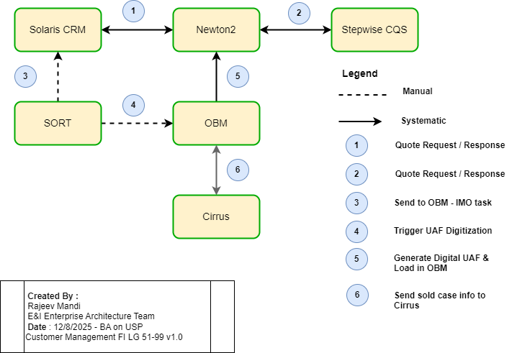
Architecture Interactions Context Diagram –
Customer Management – Customer Installation & Implementation
( New Business – FI 51-99 )

Slide 14
BA Customer Management : Sold Case Installation & Implementation –Application Impacts (Fully Insured (FI) – Large Group 51-99)
DRAFT
SORT:
As part of existing process, IMO team assigned to work on sold case group, will setup task in SORT and manually trigger the ‘Send to OBM” task to release the uploaded UAF in Solaris and to trigger the UAF Digitization process.
OBM:
The ‘Send to OBM’ task will enable the Case Installation team to key in the Opportunity ID from Solaris for sold case and use it to systematically pull the UAF information for a sold case from Newton back-end tables and load it into OBM. This existing process needs to be updated to pull additional information related to BA from Newton back-end tables via the API to support UAD Digitization process.
There are coding mapping changes that need to be made in OBM corresponding to the changes already made to the HW API to support the automation of New Business customer sold case installation process for BA in Cirrus.
To support sales broker compensation by state specific guidelines, OBM will need to include logic to override the broker commission received from Solaris with state specific broker commission max rate and stream it BASICS. OBM has UI changes to include additional states, legal entities ( NJ & NY, we have to expand logic for additional states and codes etc.) default is 10%
Cirrus:
The ‘HW API changes have already been made by Cirrus awhile ago, after the coding mapping changes are made in OBM, we need to test the automation of sold case installation in Cirrus when the process is triggered by OBM calling the HW API.
Cirrus has made changes to CCV3 API to support renewals however there was a gap was discovered recently when a group terminates BA then the members enrolled in BA were not getting terminated and it was tedious task to terminate individual members of group manually one by one. So, a new feature has been created to resolve this issue, i.e. to have notification pop-up in member UI screen if the group has termed BA and member ops team will manually term the member from BA as well.
As part of BA testing effort, CCV3 and HW APIs will need to be tested for all the typical use cases like Add coverage, change a plan, term a plan etc.

Slide 15
Customer Management Product Family Capabilities:
Billing
Consolidated Billing Invoice &
Premium Revenue Booking - Large Group 51-99

Slide 16
Phase 2 - BA FI 51-99 - High Level requirements for Billing
Name | Functionality Required | In Scope | Out of Scope | Team
Billing | The standard business requirement is to have the medical and supplemental health premiums billed together (combined into one rate) on a monthly basis. The business also requires that we have the ability to book revenue across any license (i.e. medical license may differ from supplemental). We also need the functionality to break premiums out if requested by the client; meaning benefit ally rates should be separate from medical. This is the same exact functionality offered for Oxford KA 100+ FI NY and NJ. ( 51-99 FI we don’t have NY) | AK, AL, AR, AZ, DC, DE, FL, GA, HI, IA, ID, IL, IN, KS, KY, LA, MA, MD, ME, MI, MN, MO, MS, MT, NC, ND, NE, NH, NJ, NV, OH, OK, OR, PA, RI, SC, SD, TN, TX, UT, VA, WA, WI, WV, WY, CO Oxford Markets: NJ | NM, CT, VT, CA, NY | Shelly Salemi

Slide 17
BA Customer Management : Billing Consolidated Invoice &
Premium Revenue Booking – Application Impacts
(Fully Insured (FI) – Large Group 51-99 NB)
DRAFT
Cirrus:
Cirrus has already made changes to create foundational capabilities to support NB FI Oxford 100+ group size on USP in 2021/2022, and this same functionality will be used to support the NB UHC FI & Oxford 51-99 group size market expansion rollout on USP.
As part of the testing effort, we need to verify that the following changes made in Cirrus in past to support the NB FI Oxford 100+ group will also work for NB UHC FI & Oxford 51-99 group size:
  Ensure that new attribute to capture customer bill preference for consolidated billing was added and can be used for BA FI 51-99.
  Ensure separate new billing type values for 3 different components of BA (Critical Illness, Accident & Hospital Indemnity) is available for use in Cirrus for NB UHC FI & Oxford 51-99 group size.
  Ensure we can create new plans and use tables and same values for Financial Protection & 3 insurance components of BA , bill item types & financial activity codes that were created for NB FI Oxford 100+ group size can be used for NB UHC FI &Oxford 51-99 group size.
  Ensure Cirrus can support both plan options for BA (Value & Enhanced) and multiple legal entities and BA insurance rates for NB UHC FI & Oxford 51-99 group size
  Ensure Cirrus can send BA information to downstream systems via Nimbus streaming which include the information on the individual supplemental health insurance components and rates (HIPP, CIPP & APP).
  Ensure the financial tagging rules established in Cirrus for BA will work and flow the financial tagging information down to BRMS, Cirrus PCMT, FTS & BASICS
Note: Cirrus changes related to plan structure for FPP, bill item types, and financial activity code needed to support BA were made in past we need to verify that those changes will still work and support the NB UHC FI & Oxford 51-99 group size business as well. All the plan structure changes made in Cirrus to support BA were included in the Nimbus changes to stream the BA information to downstream systems in past.

Slide 18
BA Customer Management : Billing Consolidated Invoice &
Premium Revenue Booking – Application Impacts
(Fully Insured (FI) – Large Group 51-99 NB)
DRAFT
BRMS:
BRMS has already made changes to create foundational capabilities to support NB FI Oxford 100+ group size on USP in 2021/2022, and these same functionality will be used to support the NB UHC FI & Oxford 51-99 group size market expansion rollout on USP.
As part of the testing effort, we need to verify that the following changes made in BRMS in past to support the NB FI Oxford 100+ group will also work for NB UHC FI & Oxford 51-99 group size :
Ensure BRMS can evaluate and make changes to read customer billing preference and support roll-up of BA premiums into medical for Billing. BRMS has made changes to read the two plan options for BA ( Value & Enhanced) sold to USP customers
Ensure BRMS can evaluate and has already made changes to support financial tagging process to include the new bill item types received from Cirrus, corresponding to 3 insurance components of BA and map it to corresponding BA charges /financial activity codes.
Ensure BRMS can evaluate and has already made changes to existing feed to BASICs to include BA information
Ensure BRMS can read the information related BA plan and has already made changes to include logic to append ‘BA Value’ or ‘BA Enhanced’ in plan name with appropriate updates to disclaimer content on the invoice
Ensure BRMS can evaluate and has already made changes to existing medical premium reporting to exclude BA Premium revenue from it. (Note: the BDPAAS reporting solution that was used in past was slated to move to BRS ( Billing Reporting Solution) to replace BDPAAS, we need to verify that this migration has occurred, and the report excludes the BA premium revenue for NB UHC FI & Oxford 51-99 group size reporting as well. )

Slide 19
Sales Compensation & Broker Commissions for BA Capabilities:
Commissions & Bonus / Sales Compensation
Sales Comp & Broker Commission & Bonus- Large Group NB 51-99

Slide 20
Phase 2 - BA FI 51-99 - High Level requirements for Commissions & Bonus / Sales Compensation
Name | Functionality Required | In Scope | Out of Scope | Team
Commissions and Bonus | Build the Benefit Ally commission structure for all states is now variable (currently built within USP); 0-25% for all in scope states; does not apply to NY. There are states where there are max commission amounts that we must adhere to. BA defaults to 10 % and it can be varied | AK, AL, AR, AZ, DC, DE, FL, GA, HI, IA, ID, IL, IN, KS, KY, LA, MA, MD, ME, MI, MN, MO, MS, MT, NC, ND, NE, NH, NJ, NV, OH, OK, OR, PA, RI, SC, SD, TN, TX, UT, VA, WA, WI, WV, WY, CO Oxford Markets: NJ | NM, CT, VT, CA, NY | Rosemarie Williams Joel Shaw
Sales Compensation | Ensure data flows and is accessible to Bob Carrigan (Finance) team to book compensation for sales for Benefit Ally |  |  | Bob Carrigan

Slide 21
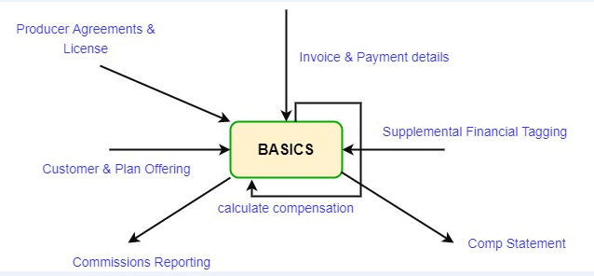
High Level Architecture – Broker Commissions – Context Diagram
(Current State – BA USP – BASICS implementation )
DRAFT

Slide 22
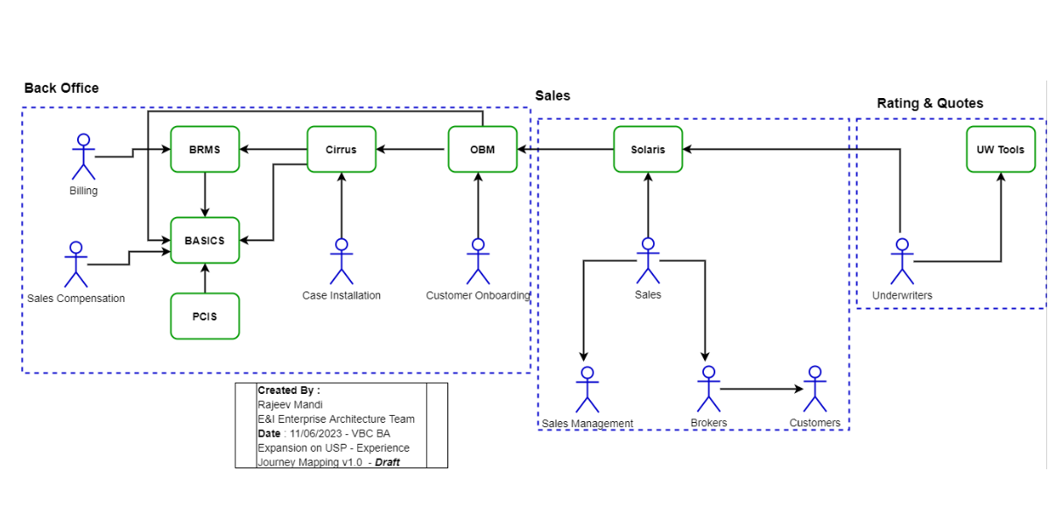
Sales Compensation Capability on USP – High Level Experience Journey Map

Slide 23
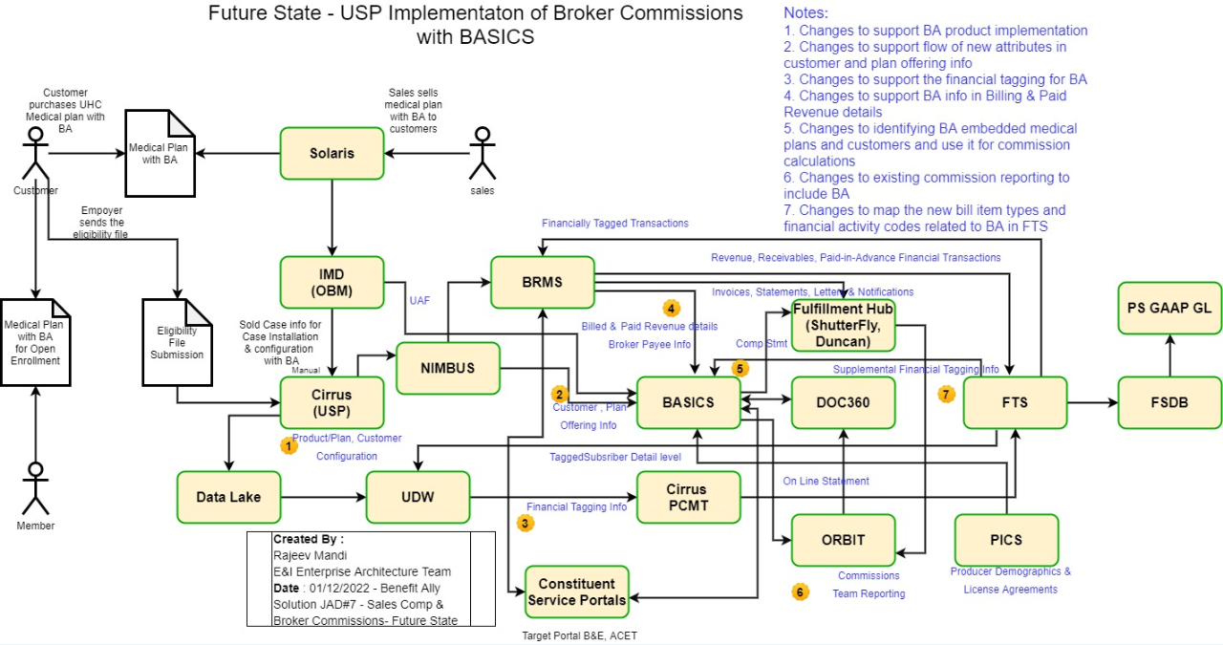
High Level E2E Architecture – Broker Commissions & Bonus
(Current State)
DRAFT

Slide 24
Sales Comp & Broker Commission & Bonus – Application Impacts
Broker Commissions:
Cirrus:
Cirrus has already made changes to Customer and Plan Offering info to support BA and flows BA info to BASICS.
Cirrus has already made necessary changes to do the financial tagging for BA charges and flows this info down to Cirrus PCMT & FTS via UDW
BASICS:
BASICS has already made changes in past to read the BA related information from Cirrus, FTS & BRMS and use it in its internal compensation calculations in BASICS, we need to test this functionality for FI UHC & Oxford 51-99 group size
BASICS already uses BA specific information and leverages existing processes related to creating compensation statement and reporting for BA. We will use the same processes and existing capability to support FI UHC & Oxford 51-99 group size. We need to test it out.
BASICS has already made changes in past to read BA related attribute and values received in its existing BRMS feed and include it in its compensation calculation logic; we just need to test it out for the NB UHC FI & Oxford 51-99 group size.
The broker commission rates can vary between 0% to 25% and there are some states which stipulate what broker commission rates can be charged for BA, we need to follow this state specific guidelines, and this state specific broker commission rates captured in OBM will override the broker commission inputs from Solaris, and BASICS needs to read these state specific broker commission rates by states from the OBM from the stream and load the info to BASICS . Any new attribute values in existing stream needs to be read by BASICS and be loaded into BASICS for use in its compensation calculation logic.
BASICS needs to implement additional validation around the state specific max broker commission rates allowed for BA.
Note: BRMS changes to its feed to BASICS were already made in the past, and it needs to be tested as part of the Billing capability.
DRAFT

Slide 25
C101747 & C101748– Dependencies & Assumptions
DRAFT
OBM:
OBM already streams data to BASICS and the changes to allow variable broker commission rates for BA general agents was made as part of the BA variable broker commission rates initiative in past, we need to verify and ensure that there is logic in OBM to read the state specific guard rails for max broker commission rate for BA and include the appropriate broker commission rate and situs state information in its current data streaming process to BASICS. If there is no logic in OBM currently to read the state specific broker commission rate, then we need to build this functionality in OBM and update the structure to include additional attributes and send the information to BASIC via existing data streams.
Sales Compensation:
MyIncentive Compensation System:
Calculate internal sales compensation for the Benefit Ally supplemental health products based on the revenue recorded for the corresponding supplemental health products, new financial activity & bill item type codes (CLC) defined for BA supplemental health products, and commission calculation.
Update existing reports to include USP sales for BA
MyIncentive Compensation System was used to calculate the compensation for internal sales staff for USP as well, and it follows the existing manual processes that is currently in place for UNET implementation
Note : need to validate the current state process with the Business contact supporting internal sales compensation for BA.

Slide 26
Financial Management Product Family Capability :
Supplemental Health - Finance
Financial Accounting & Reporting - Large Group NB 51-99

Slide 27
Phase 2 - BA FI 51-99 - High Level requirements for Finance
Name | Functionality Required | In Scope | Out of Scope | Team
Supplemental Health Finance | Ensure that we create the appropriate supplemental health financial structure to book revenue; there are three bill item types that can be booked by the Supplemental Health Finance team and be able to book revenue across multiple licenses (financial tagging). Cirrus sends the member counts for FPP and we need to include the BA member counts there is separate financial protection extract process for accounting. | AK, AL, AR, AZ, DC, DE, FL, GA, HI, IA, ID, IL, IN, KS, KY, LA, MA, MD, ME, MI, MN, MO, MS, MT, NC, ND, NE, NH, NJ, NV, OH, OK, OR, PA, RI, SC, SD, TN, TX, UT, VA, WA, WI, WV, WY, CO Oxford Markets: NJ | NM, CT, VT, CA, NY | Sara Swenson

Slide 28
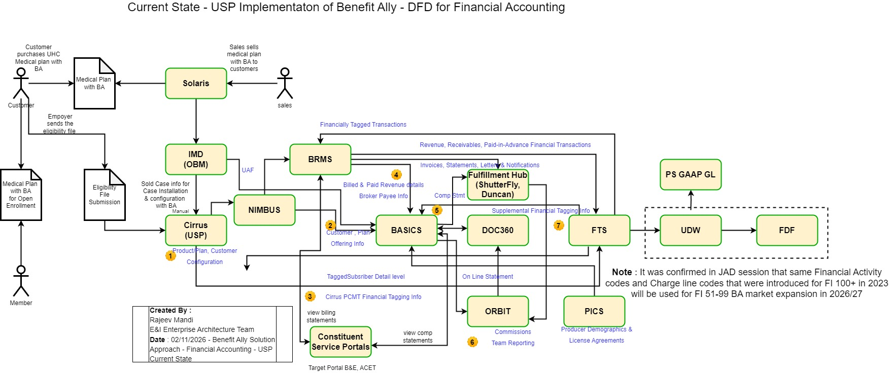
High Level E2E Architecture – Financial Accounting & Reporting
(Current State)
DRAFT

Slide 29
Financial Management Capability – Financial Accounting & Reporting – Application Impacts
Financial Accounting & Reporting: Supplemental Health Finance
Cirrus:
Cirrus has already made changes in past to implement 3 new bill item types and financial activity codes in Cirrus corresponding to 3 supplemental health insurance components, to support the financial accounting and reporting for BA UHF FI Oxford 100+, this same functionality and new bill item types and financial activity codes will be used for the rollout of BA to NB UHC FI & Oxford 51-99 group
Cirrus has already made necessary changes to setup financial tagging rules and to do the financial tagging for BA charges and flows this info down to Cirrus PCMT & FTS via UDW
PCMT Extract:
We need to verify and test the changes that were made in past to implement new bill item type, financial activity code and financial tagging rules for UHC FI Oxford 100+ will also work for the NB UHC FI & Oxford 51-99 group size, by running the PCMT extract process in lower environment via UDW and loading the file in FTS and verifying the flow of data to downstream financial systems like FSDB , PS GL etc.
Note: the premium from BA are excluded from the premiums book for medical and this is done in BRMS reporting.
We need to verify if there is any manual Supplemental Health Finance reporting or reconciliation that is happening and determine if the current process will support the BA UHC FI & Oxford 51-99 group size as well.
DRAFT

Slide 30
Member Management Product Family Capability & DRA 1099 Reporting Capability:
Supplemental Health Implementation
Eligibility & Financial 1099 Tax Reporting - Large Group NB 51-99

Slide 31
Phase 2 - BA FI 51-99 - High Level requirements for 1099 Tax Reporting & Claims Payment
Name | Functionality Required | In Scope | Out of Scope | Team
Supplemental Health Implementation | Send 51-99 FI Oxford and UHC data (claims and eligibility) from ARA to OnBase to setup policy within OnBase; Taxation will also be required to be setup within OnBase prior to client/policy activation and need stop gap to ensure data will not flow to OnBase until taxation is setup. | AK, AL, AR, AZ, DC, DE, FL, GA, HI, IA, ID, IL, IN, KS, KY, LA, MA, MD, ME, MI, MN, MO, MS, MT, NC, ND, NE, NH, NJ, NV, OH, OK, OR, PA, RI, SC, SD, TN, TX, UT, VA, WA, WI, WV, WY, CO Oxford Markets: NJ | NM, CT, VT, CA, NY | Kathy McBride Jonathan Mohr Uday Vishnudas
Supplemental Health Administration | Setup OnBase to ingest claims and eligibility information for the 51-99 FI UHC and Oxford membership to pay claims for each of the eligible markets. Ensure all materials sent to the member post processing like the EOB and buck slip are updated to reflect any state nuances (like NY) or to adhere to plan branding or license. OnBase must have all coding completed by market which should be completed as part of the USP expansion. Requesting we validate as part of solutioning discussions. | AK, AL, AR, AZ, DC, DE, FL, GA, HI, IA, ID, IL, IN, KS, KY, LA, MA, MD, ME, MI, MN, MO, MS, MT, NC, ND, NE, NH, NJ, NV, OH, OK, OR, PA, RI, SC, SD, TN, TX, UT, VA, WA, WI, WV, WY, CO Oxford Markets: NJ | NM, CT, VT, CA, NY | Kathy McBride Jonathan Mohr Uday Vishnudas

Slide 32
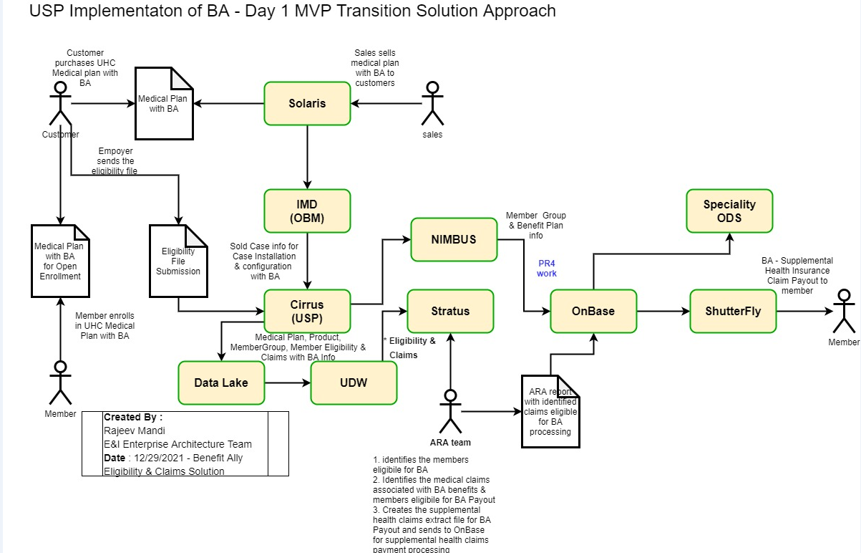
Eligibility & Claims (Medical & Supplemental) - Large Group 99+) – Current State

Slide 33
Member Management Capability – Financial Tax Reporting – Application Impacts
Supplemental Health Plan Implementation : Eligibility & 1099 Tax Reporting
Cirrus:
Cirrus has already made changes in past to utilize standard processes to load eligibility files containing member group and member enrollment information received from customers into Cirrus
Cirrus and Nimbus have made changes in past to flow the eligibility information to downstream systems via the near real time Kafka data streaming and via updates to the Nimbus APIS. We just need to verify and test that existing functionality will also support the UHC FI Oxford 51-99 group size as well.
implement 3 new bill item types and financial activity codes in Cirrus corresponding to 3 supplemental health insurance components, to support the financial accounting and reporting for BA FI Oxford 100+, this same functionality and new bill item types and financial activity codes will be used for the rollout of BA to UHC FI & Oxford 51-99 group
Cirrus has already made necessary changes to setup financial tagging rules and to do the financial tagging for BA charges and flows this info down to Cirrus PCMT & FTS via UDW
OnBase:
We have made changes in the past to support OnBase to pick the BA Eligibility information from the Nimbus Kafka data streams and load the eligibility information into OnBase, we need to verify and test this existing functionality will work for 51-99 group size as well.
The eligible Claims information currently flow from Cirrus to UDW and RRT team has setup batch processes to create claims extract file and send it to OnBase which utilizes FPBOTS to load the claims information from Cirrus into OnBase.
The policy information is setup in OnBase and the 1099 Tax reporting is currently supported by the RRT team and Specialty Finance creates reports from Specialty ODS.
DRAFT

Slide 34
Claims Management Product Family Capability : Claims Payment & Presentment
Supplemental Health Administration
Claims EOBs & Eligibility - Large Group NB 51-99

Slide 35
Claims Management Capability – Claims Payment & Presentment
Claims EOBs – Application Impacts
Supplemental Health Plan Administration : Claims EOBs, Buck Slips etc.
Cirrus:
Cirrus has already made changes in past to utilize standard processes to load eligibility files containing member group and member enrollment information received from customers into Cirrus and the BA member eligibility information is published to Nimbus Kafka data streams for downstream consumption.
Cirrus has already made changes in past to send the medical claims information associated with BA members to UDW via Data Lake.
UDW:
There are batch processes already setup by RRT to create medical claims extract file for BA members and send it to FPBOT for it to be processed and loaded into OnBase. We need to validate this existing batch process can handle additional UHC FI & Oxford 51-99 group volume.
OnBase:
Currently the supplemental health claim gets processed and paid on the OnBase system, however no supplemental health claims EOB or letter that is generated and sent to the member, this is existing functionality gap. (There was item on OnBase product backlog to generate letter for member who get their claims processed on OnBase and it was not implemented in past)
We need to send the supplemental health claim information for EOB generation from OnBase to Shutterfly to generate the Supplemental claims EOB or use the existing medical EOB claims process and modify it to include the supplemental claim information and send it out to BA members.
Implement the appropriate branding (name and logo) in the EOB statements as per the state specific guidelines and license requirements.
The customer preference related to 1099 Tax reporting needs to be picked up by OnBase from the stream as part group eligibility information
.
DRAFT

Slide 36
Member Management Product Family Capability : Member Fulfillment
Supplemental Health Contracts & Fulfillments
Supp COCs - Large Group NB 51-99

Slide 37
Phase 2 - BA FI 51-99 - High Level requirements for Contracts & Fulfillment
Name | Functionality Required | In Scope | Out of Scope | Team
Supplemental Health Contracts & Fulfillment | Build an automated process - similar to Oxford FI NY/NJ 100+ where we can automate the COC and make accessible via Doc360; this requirement needs to be vetted with RRT team before we move forward with this requirement. | AK, AL, AR, AZ, DC, DE, FL, GA, HI, IA, ID, IL, IN, KS, KY, LA, MA, MD, ME, MI, MN, MO, MS, MT, NC, ND, NE, NH, NJ, NV, OH, OK, OR, PA, RI, SC, SD, TN, TX, UT, VA, WA, WI, WV, WY, CO Oxford Markets: NJ | NM, CT, VT, CA, NY | Jonathan Mohr, Valerie Martinez, Karthik Thilager, Michael Dircz

Slide 38
Member Management – Member Fulfillment – Supplemental Health COCs NB Large Group 99+ – Current State

Slide 39
Member Management Capability – Member Fulfillment
COCs – Application Impacts
Supplemental Health Contracts & Fulfillment : Current State process
AXIS:
IMO Implementation Manager assigned to sold case will manually open task in AXIS to have the supplemental health COCs generated.
OBM:
OBM will do the customer onboarding and compile the sold case information for the customer. Cirrus has already made changes in past to utilize standard processes to load eligibility files containing member group and member enrollment information received from customers into Cirrus and the BA member eligibility information is published to Nimbus Kafka data streams for downstream consumption.
Cirrus has already made changes in past to send the medical claims information associate with BA members to UDW via Data Lake.
Supplemental Health COC Automation BOT:
RRT has created automation BOT few years ago, which looks at AXIS backend tables and identifies the tasks for creation of COCs and then it gathers the necessary Customer sold case information from OBM and fetches the appropriate COCs template from NAS drive and populates it and generates the COCs and uploads it into DOC360 and sends email notifications to business OPS team.
The business OPS team pulls the Supplemental Health COCs for BA and packages it with medical COCs and sends it to members.
The Supplemental Health Ops team manually creates the templates for the COCs and stores it in the NAS drive.
Note: Business needs to make decision if we are going to leverage the current state process for Supplemental COCs or pivot to using the strategic COM360 asset for generating the Supplemental Health COCs to support the BA FI 51-99 market expansion.
.
DRAFT

Slide 40
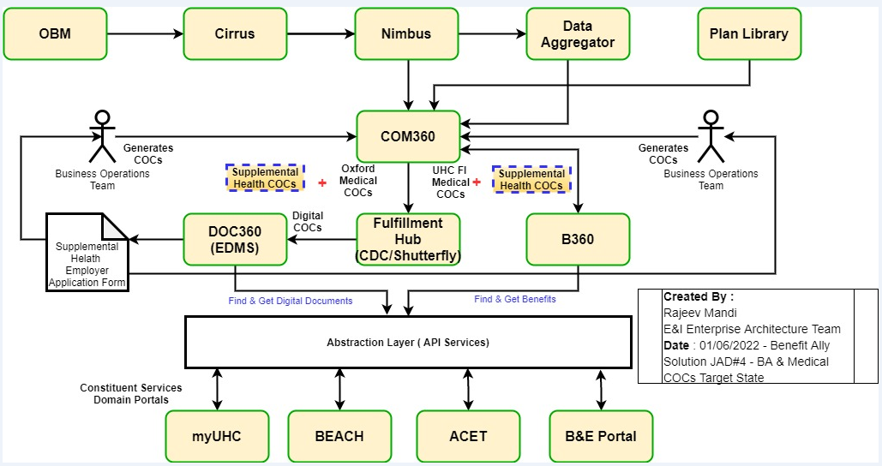
Large Group 99+ – Medical COCs & BA COCs
(Fulfillment Materials) – Future State – Target Architecture
DRAFT

Slide 41
Member Management Product Family Capability : Member Self Service
Member Access to Benefit Ally Information
Benefit Summaries - Large Group NB 51-99

Slide 42
Phase 2 - BA FI 51-99 - High Level requirements for Member Access to BA info
Name | Functionality Required | In Scope | Out of Scope | Team
Member Access to Benefit Ally Information | DOB's accessible via myuhc.com - all documents MUST go through UA before posting - need process for this. | AK, AL, AR, AZ, DC, DE, FL, GA, HI, IA, ID, IL, IN, KS, KY, LA, MA, MD, ME, MI, MN, MO, MS, MT, NC, ND, NE, NH, NJ, NV, OH, OK, OR, PA, RI, SC, SD, TN, TX, UT, VA, WA, WI, WV, WY, CO Oxford Markets: NJ | NM, CT, VT, CA, NY | Jonathan Mohr, Valerie Martinez, Karthik Thilager and

Slide 43
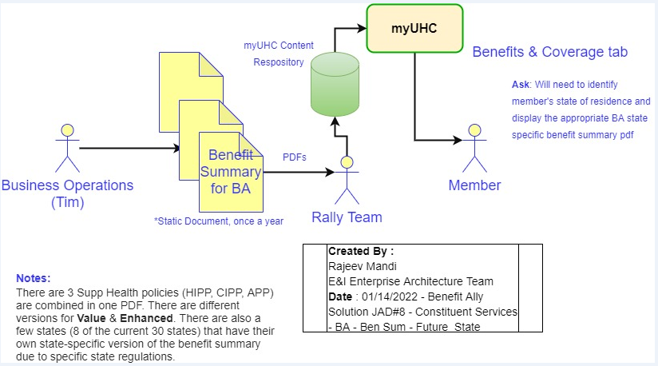
Member Portal – Member Self Service
Member Access of BA info (Current State)
DRAFT

Slide 44
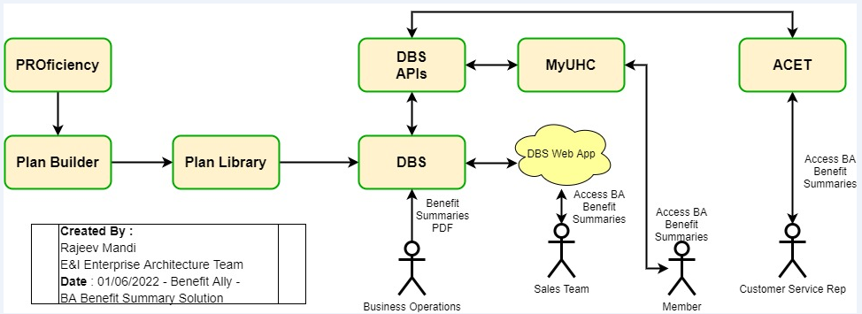
High Level Architecture – Member Portal & ACET
Benefit Summaries Document – Target State Architecture
DRAFT

Slide 45
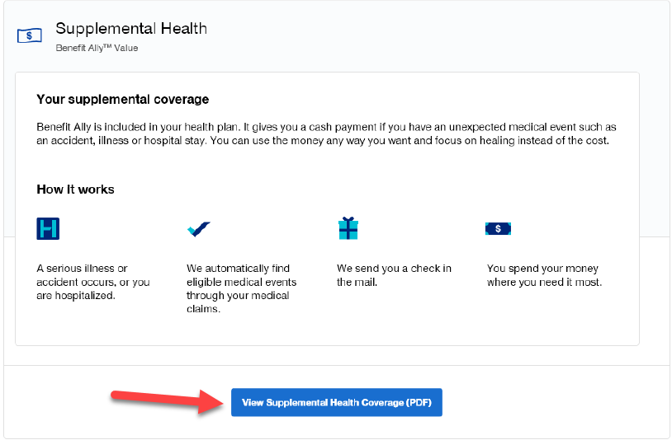
(Current State – USP – BA Supplemental Health content displayed in myUHC)
DRAFT

Slide 46
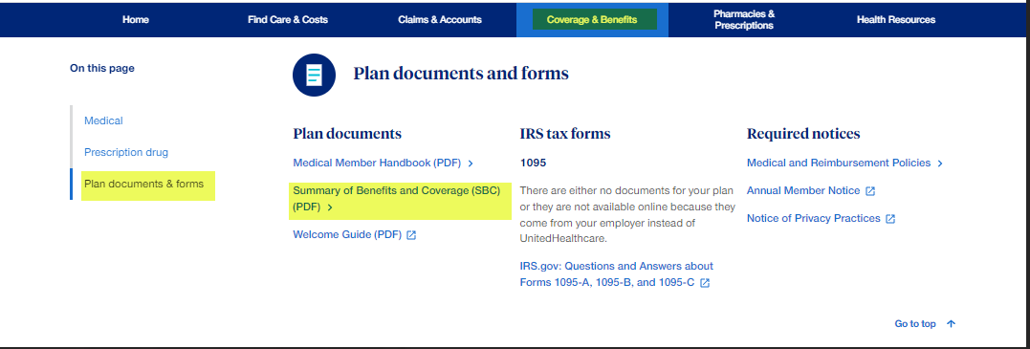
Current State – USP – SBC pdf & content displayed under Coverage & Benefits tab in myUHC
DRAFT

Slide 47
Member Portal – Member Self Service - Member Access of BA info
(Large Group 100+ ) – Applications Impact
DRAFT
  myUHC:
  Validate if the process that was implemented in 2022 as part of BA Oxford 100+, to intake the benefit summary PDF document for BA and store it in its internal content repository and fetch and retrieve the document using its existing API services and display benefit summary document to eligible BA member under the Coverage & Benefits tab – Plan & Documents section of member portal is still in place and being used.
  Validate if the DBS solution approach that was proposed in 2022 was implemented, i.e. to have business ops team create the Benefit Summaries document in DBS and store it in DBS repository, then create integration of consumer portals like myuhc with DBS API to fetch and display the Benefit Summary document for BA from DBS repository to eligible BA member under the Coverage & Benefits tab – Plan & Documents section of member portal.
  Validate what APIs myuhc is using, and whether its existing APIs need to be retrofitted to include new BA attributes which will enable myUHC to identify and create awareness of which members are eligible for BA on member portal
  Note: need to validate the current state with myuhc team. What APIs are being used to fetch BA benefit summary info. Have the APIs changed over the years.?
  Verification Updates: It seems the current BA functionality in myuhc is not working as there was production issue reported around in 2025, and I believe the production issue was resolved, however we had done quick verification with few member records with myuhc team in 2026, and it still didn’t work so this issue needs to be fixed. Either as part of this initiative under this capability or by logging production incident.
  Question: Currently myuhc can shows medical claims, similarly is there a requirement to do we have requirement to display BA claims in myuhc. ? ( TBD)

Slide 48
Sales Product Family Capability : Sell To Customers
Broker and Employer Access to Benefit Ally Information
Constituent Services - Large Group NB 51-99

Slide 49
Phase 2 - BA FI 51-99 - High Level requirements for Broker & Employer Access to BA
Name | Functionality Required | In Scope | Out of Scope | Team
Broker and Employer Access to Benefit Ally Information | Make COC's and invoices available via B&E portal for 51-99 for Oxford and UHC. | AK, AL, AR, AZ, DC, DE, FL, GA, HI, IA, ID, IL, IN, KS, KY, LA, MA, MD, ME, MI, MN, MO, MS, MT, NC, ND, NE, NH, NJ, NV, OH, OK, OR, PA, RI, SC, SD, TN, TX, UT, VA, WA, WI, WV, WY, CO Oxford Markets: NJ | NM, CT, VT, CA, NY | Jonathan Mohr, Valerie Martinez, Karthik Thilager

Slide 50
Sales – Sell to Customers - Brokers Access of BA info
(Large Group 100+ ) – Applications Impact
DRAFT
  B&E Portal:
  Need to validate in B&E portal, and ensure existing process displays the benefit summary PDF document and COCs
  Need to validate in B&E portal if we currently display the billing statements for customers?.
  Need to validate in B&E portal if we currently display any BA reports for customers?
  Need to validate in B&E portal if we are displaying any BA materials or content on the site?
  Note: need to validate the current state with B&E portal team

Slide 51
Advocacy Product Family Capability : Guided Experience
Customer Service
Constituent Services - Large Group NB 51-99

Slide 52
Phase 2 - BA FI 51-99 - High Level requirements for Customer Service
Name | Functionality Required | In Scope | Out of Scope | Team
Customer Service | Ensure customer support (OST) and supplemental health customer support are able to intake the volume for 51-99 for Oxford and UHC. Process should not change for customer service - it should be the exact same for KA FI 100+ Oxford NJ. | AK, AL, AR, AZ, DC, DE, FL, GA, HI, IA, ID, IL, IN, KS, KY, LA, MA, MD, ME, MI, MN, MO, MS, MT, NC, ND, NE, NH, NJ, NV, OH, OK, OR, PA, RI, SC, SD, TN, TX, UT, VA, WA, WI, WV, WY, CO Oxford Markets: NJ | NM, CT, VT, CA, NY | Jennifer Hamilton and Harpreet Churiwalla

Slide 53
Advocacy – Customer Service – ACET display of BA info
(Large Group 100+ ) – Applications Impact
DRAFT
  ACET USP Commons:
  When BA was initially rolled out to Oxford FI 100+ at that ACET was using hard coding to interpret the BA plan code and add static text BA in the ACET GUI.
  Since the initial implementation of BA , the ACET application has been split into ACET USP Commons and ACET BEO
  ACET USP Commons tool is used by CSR to support the member inquiry calls.
  We need to switch from hard coding to using the standard APIs in ACET USP Commons tool to display BA eligibility and plan information.
  ACET BEO:
  ACET BEO tool is used by CSR to support the Broker inquiry calls.
  We need to switch from hard coding to using the standard APIs in ACET BEO tools to display BA eligibility and plan information.
  Note: need to validate the current state with ACET teams
  When we initially implemented BA, we had to build logic in ACET to show "Benefit Ally" based on certain plan codes since there was nothing in the API response that said, "Benefit Ally". It only showed the SH plan option.
  The HCP Eligibility GQL API is now used by ACET USP, we need to ensure that this API provides the BA information in its response. If the BA info is not showing in the API response we have impact HCP./Nimbus.

Slide 54
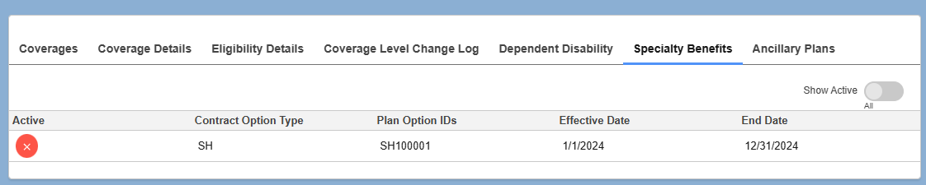
High Level Architecture – ACET USP Commons
BA Coverage Display in ACET for Customer Service Rep
DRAFT

Slide 55
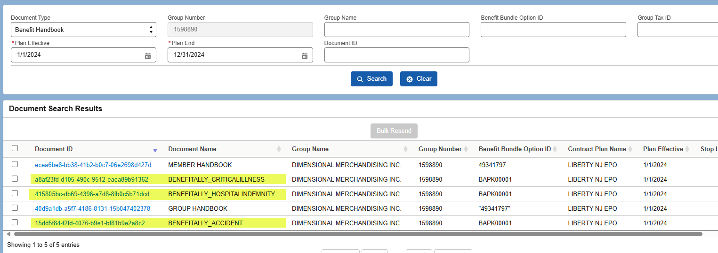
High Level Architecture – ACET USP Commons
BA Benefit Summaries Display for Customer Service Rep
DRAFT

Slide 56
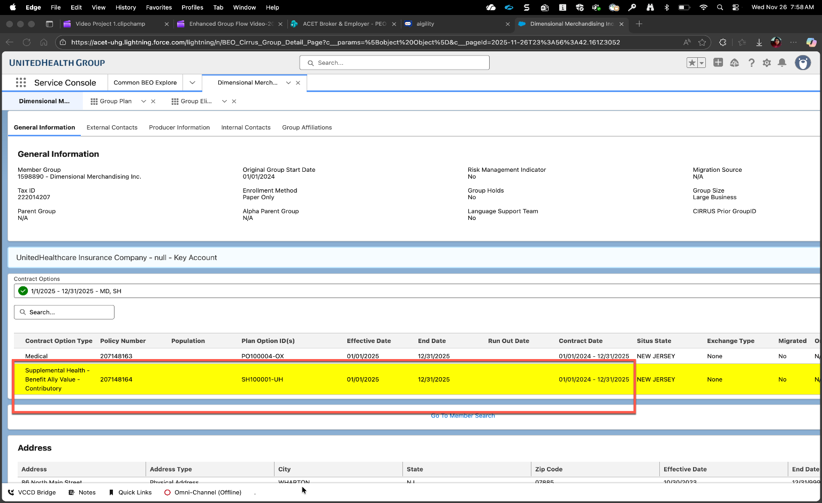
ACET BEO – Application Impacts
General Information Display
DRAFT

Slide 57
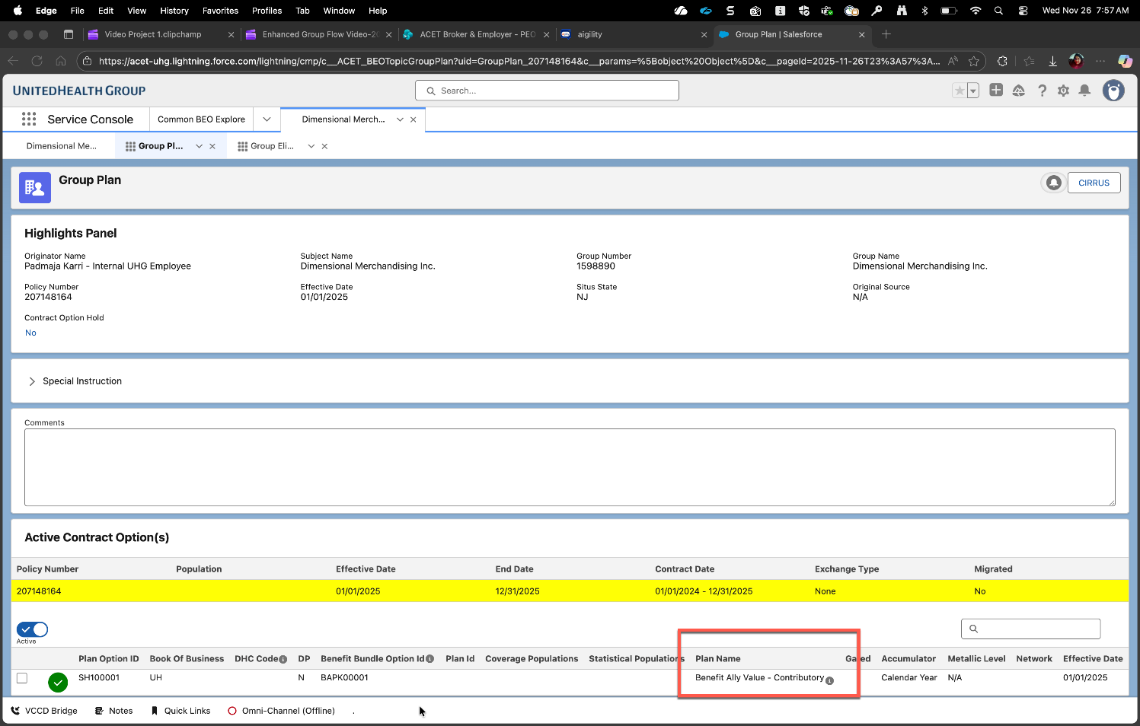
ACET USP Commons – Application Impacts
Group Plan Info Display
DRAFT

Slide 58
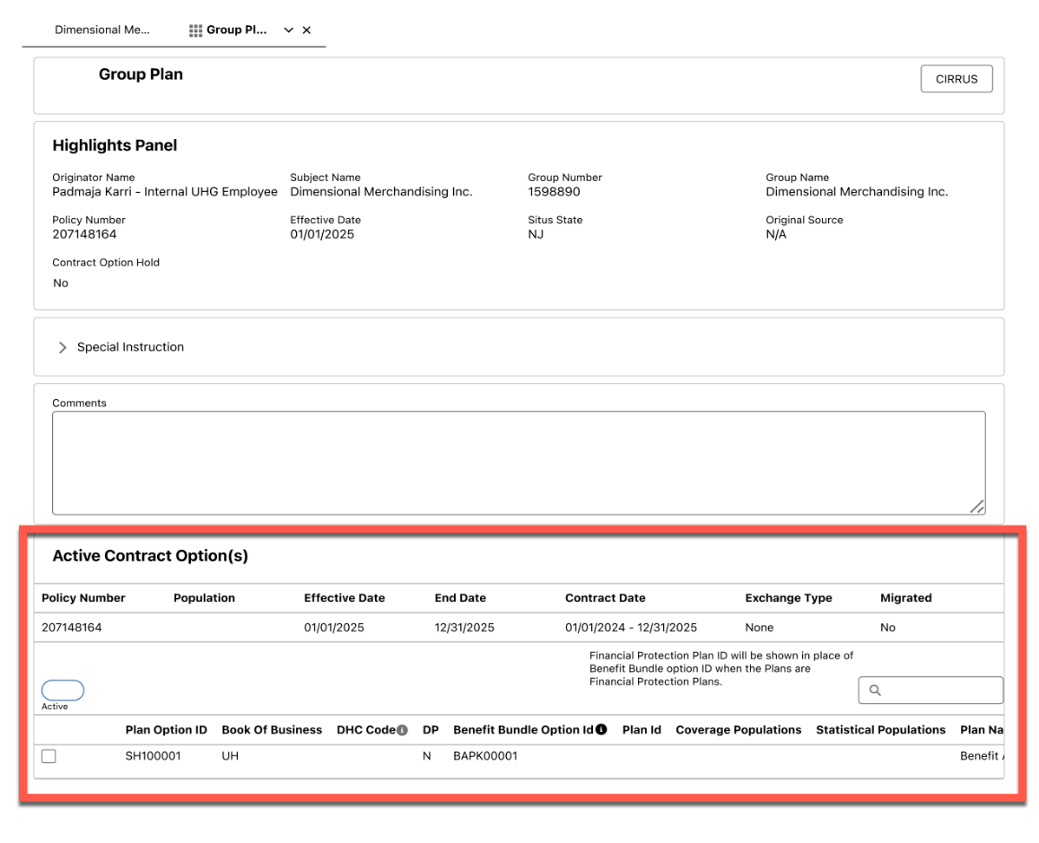
High Level Architecture – ACET USP Commons
Group Plan Display with Contract Options
DRAFT

Slide 59
DRA Product Family Capability : Operational & Analytical Reporting
Supplemental Health Reporting
BA Customer Reporting - Large Group NB 51-99

Slide 60
Phase 2 - BA FI 51-99 - High Level requirements for Supplemental Health Reporting
Name | Functionality Required | In Scope | Out of Scope | Team
Supplemental Health Reporting | Ensure reporting and appropriate data fields is accessible via PRO/Tableau team to report on; requirements will be to report both UHC and Oxford 51-99 membership by market, by client, by supplemental health product (CIPP/HIPP/APP). | AK, AL, AR, AZ, DC, DE, FL, GA, HI, IA, ID, IL, IN, KS, KY, LA, MA, MD, ME, MI, MN, MO, MS, MT, NC, ND, NE, NH, NJ, NV, OH, OK, OR, PA, RI, SC, SD, TN, TX, UT, VA, WA, WI, WV, WY, CO Oxford Markets: NJ | NM, CT, VT, CA, NY | Theresa Niu Marie Antoinette Burkhartt

Slide 61
DRA – Operational & Analytical Reporting – BA Customer Reports
(Large Group 100+ ) – Applications Impact
DRAFT
  PRO / Tableau :
  Need to validate with the Business Ops team supporting the operational and analytics reporting for BA by market segments. Identify the reporting for internal stakeholders versus external customers.
  Need to capture the current state of how BA data flows to the reporting tools used by business ops team. Identify the list of reports currently generated to report on BA.
  Identify opportunities for alignment Update existing process to intake the benefit summary PDF document for BA and store it in its internal content repository and fetch and retrieve the document using its existing API services and display benefit summary document to eligible BA member under the Coverage & Benefits tab – Plan & Documents section of member portal.
  UDW/Stratus:
  Need to validate that BA information flows to UDW and UDW stakeholders and users are able to identify BA
  Note: need to validate the current state with Reporting teams

Slide 62
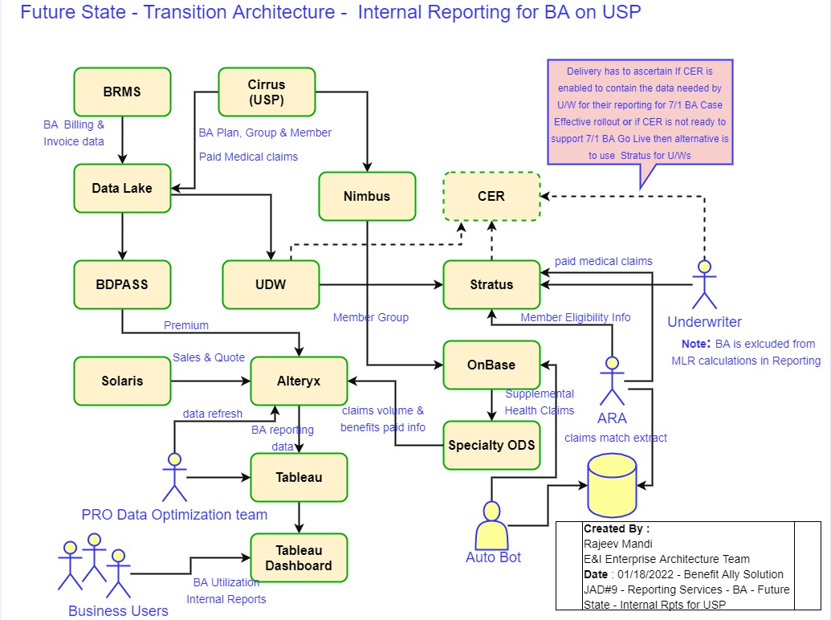
High Level Architecture – Reporting– Internal Rpts
Future State – USP – BA Reporting – Day 1
DRAFT

Slide 63
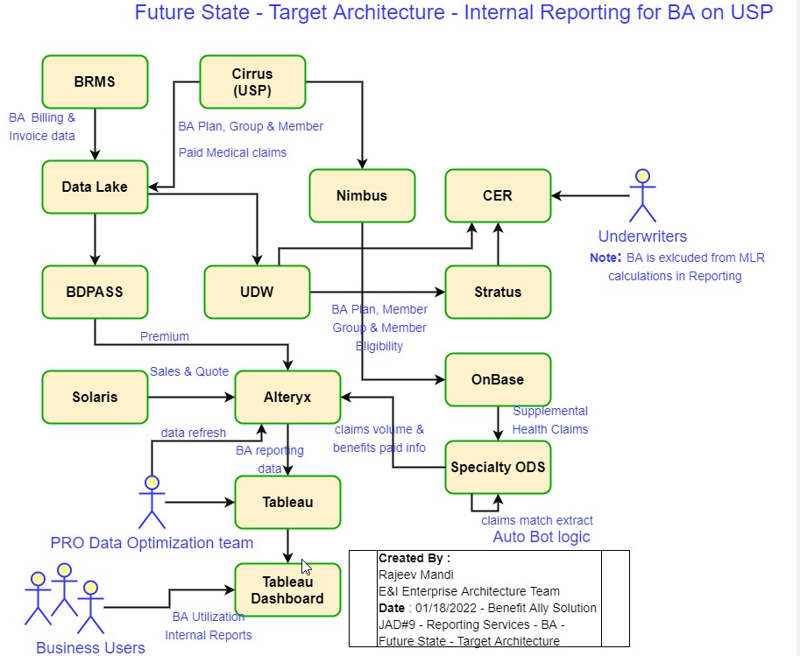
High Level Architecture – Reporting (C101744) – Internal Rpts
(Future State – USP – BA Reporting – Day 2 Target Architecture Solution )
DRAFT

Slide 64
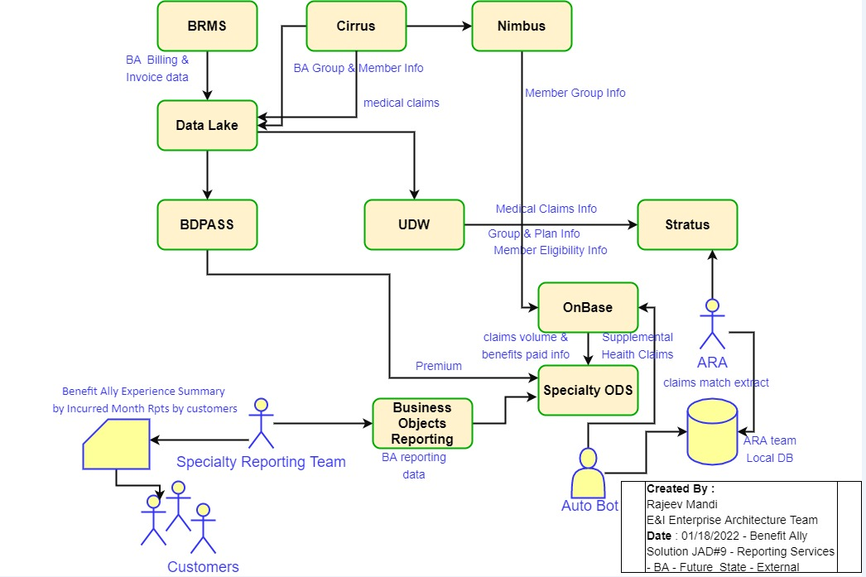
High Level Architecture – BA Reporting (C101744) – External
(Future State – USP – BA External Reports implementation for Customers)
DRAFT

Slide 65
DRAFT
BA Reporting for USP - Application Impacts
( Internal & External - Large Group 99+)
UDW:
Updates to existing data ingestion processes from Cirrus / DL to capture and store the new attributes related to BA
Updates to existing data feeds from systems downstream to UDW to include BA information, namely Stratus & CER
Stratus:
Updates to existing data ingestion processes from UDW to capture and store the new attributes related to BA
Updates to data dictionary for users to include BA related information
Provide access to ARA team and Underwriters to access data for business reporting as self service
CER:
Updates to existing data ingestion processes from UDW / Cirrus / DWAAS / Underwriting sources to capture and store the new attributes related to BA
Updates to data dictionary for users to include BA related information
Provide access to Underwriters to access data for business reporting as self service
Alteryx & Tableau:
Business Operations reporting team will make updates to existing data ingestion process to capture USP data related to BA
Update reports to include USP Data
ARA Team will update their existing reporting process to report on the BA USP transactions to support OnBase supplemental claims processing.
Note: Need to validate if the above impacts were addressed and changes completed in past ?
Notes:
Questions & Follow-Up Assignments:
– CER – impact CER as potentially TO, to ensure BA is not included in MLR
ART – we need to connect with U/W contacts about the medical renewal process and premium data flow.
Shilpa needs to be included in follow-up discussions, and SI E2E review. In interim Shilpa can review the JAD solution deck on share point and let us know if she needs to meet on any of solution capabilities.
In the claims processing solution capability JAD discussion we were informed that OnBase has the capability to use adapter to subscribe to real time data streaming. Need confirmation from OnBase Dev team, on where they are with their work related to building of POC of adapter to source the member group /plan info for BA using real time data streaming.? Has POC been operationalized for UNET implementation in production?.
Notes:
Don’t see existing report impacts, like creating new reports etc., its more of enabling the architecture and flowing the required data to downstream systems used from different sources for BA reporting for USP.
If we need the underwriters to use CER for their BA reporting needs instead of Stratus, then we will have dependency with the product roadmap of CER for 2022 and we need to see how it aligns and impacts the BA Delivery timeline for Case Effective market event.
Target Architecture state proposed as solution option can be implemented by going through one or two transitions states, given the budget constraints, delivery timeline of BA and bandwidth availability of resources from impacted applications.

Slide 66
Appendix:

